Slide 1



Department of Computer Science and Engineering
FOREST FIRE ALARM SYSTEM USING IOT
Team Members Name / Register Number
ARJUN. M. P (211420104024 )
HARISH. V (211420104092)
Guide Name & Designation
Mrs. S.T. SANTHANALAKSHMI,
M.Tech, (Ph.D)
Coordinator Name & Designation
Dr. N. PUGHAZENDI, M.E, PhD

Slide 2
INTODUCTION
In recent years, the escalating frequency and severity of forest fires have underscored the urgent need for advanced and proactive detection systems. The devastating impact of wildfires on ecosystems, wildlife, and human lives necessitates innovative solutions that go beyond traditional approaches. This paper introduces a cutting-edge forest fire detection system designed to leverage the synergy of hardware components, including a camera, NodeMCU(ESP8266), and buzzer, alongside sophisticated software elements like machine learning algorithms, Firebase cloud platform, and Arduino IDE.

Slide 3
PROBLEM STATEMENT
Forest fires pose a significant threat to both human lives and natural ecosystems. These fires can spread rapidly and cause extensive damage to forests, wildlife habitats, and nearby communities. Developing an effective forest fire alarm system using Internet of Things (IoT) technology is crucial in order to mitigate the risks associated with forest fires and enable early detection and response.
The challenges and risks associated with forest fires include:
Rapid Fire Spread: Forest fires can spread quickly, making it difficult to detect and control them in a timely manner.
Environmental Impact: Forest fires have devastating effects on ecosystems, including the destruction of wildlife habitats and the release of harmful pollutants into the air.
Human Safety: Forest fires can endanger the lives of nearby residents and firefighters, requiring effective early warning systems and evacuation plans.
Limited Monitoring: Large forested areas are often remote and difficult to monitor, making it challenging to detect fires in their early stages.

Slide 4
PROBLEM STATEMENT
The challenges and risks associated with forest fires include:
Rapid Fire Spread: Forest fires can spread quickly, making it difficult to detect and control them in a timely manner.
Environmental Impact: Forest fires have devastating effects on ecosystems, including the destruction of wildlife habitats and the release of harmful pollutants into the air.
Human Safety: Forest fires can endanger the lives of nearby residents and firefighters, requiring effective early warning systems and evacuation plans.
Limited Monitoring: Large forested areas are often remote and difficult to monitor, making it challenging to detect fires in their early stages.

Slide 5
MODULE
Hardware tools:
Camera
Node MCU
Buzzer
Software tools:
Machine Learning
Fire Base
Arduino IDE

Slide 6
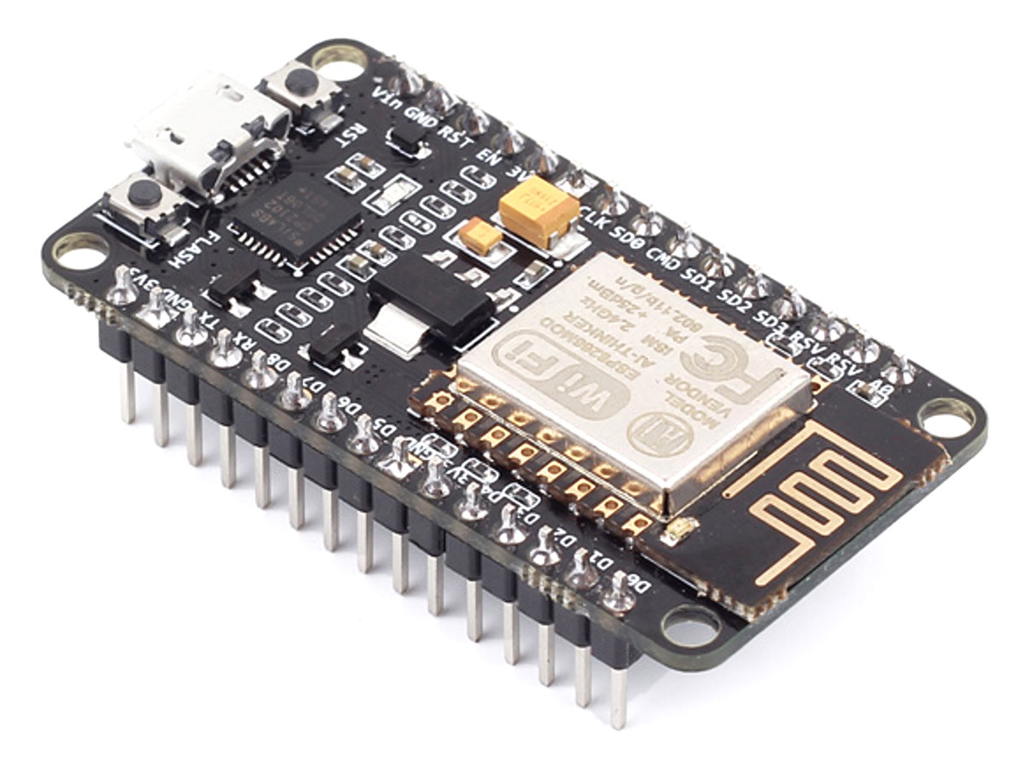
MODULE DESCRIPTION
Node MCU
The Node MCU is a low-cost open-source IoT platform that can be programmed using the Arduino IDE. It provides the foundation for connectivity and data transmission in the forest fire detection system.

Slide 7
MODULE DESCRIPTION
Buzzer
The buzzer serves as an audible alarm to alert nearby individuals of a potential forest fire, helping to ensure rapid evacuation and response.
Camera
An integrated camera module is crucial for capturing real-time images and providing visual confirmation of potential fire outbreaks.

Slide 8
MODULE DESCRIPTION
Machine Learning
Advanced machine learning algorithms analyze the captured images to detect smoke or flames, facilitating automated fire detection.
Arduino
Arduino-based microcontrollers are utilized for data processing and decision-making, ensuring swift and accurate response to potential fire incidents.

Slide 9
MODULE DESCRIPTION
FireBase Cloud-Based Forest Fire Monitoring Systems: A Review:
The forest fire detection system incorporates a Firebase cloud platform for real-time monitoring and remote accessibility. Firebase enables the secure transmission of fire alerts and relevant data, ensuring swift and coordinated responses. The cloud-based technology enhances the system's scalability and facilitates seamless integration with other components. This comprehensive approach using Firebase aims to improve forest fire management by providing timely information and supporting efficient mitigation strategies.

Slide 10
LITERATURE REVIEW
1. IoT-Based Forest Fire Detection Systems:
This seminal work explores the fundamental concepts of incorporating IoT devices equipped with environmental sensors for forest fire detection. The study emphasizes the importance of real-time data acquisition and transmission to enable timely responses.
2. Advancements in Image Processing Techniques for Wildfire Detection:
This paper delves into the application of image processing techniques, particularly in the context of camera data for wildfire detection. The authors discuss the use of computer vision algorithms, including pattern recognition and machine learning, to analyze visual cues indicative of fire.

Slide 11
LITERATURE REVIEW
3. Wireless Sensor Networks for Forest Fire Detection: A Comprehensive Review:
A comprehensive exploration of wireless sensor networks (WSNs) integrated with IoT for forest fire detection. The study evaluates the reliability and scalability of WSNs in monitoring critical environmental parameters for early fire detection.
4. Machine Learning Approaches in Forest Fire Detection: A Survey:
This survey focuses on the application of machine learning models for forest fire detection using camera imagery. The paper discusses the training and implementation of algorithms capable of distinguishing between normal environmental conditions and potential fire events.

Slide 12
LITERATURE REVIEW
5. FireBase Cloud-Based Forest Fire Monitoring Systems: A Review:
The forest fire detection system incorporates a Firebase cloud platform for real-time monitoring and remote accessibility. Firebase enables the secure transmission of fire alerts and relevant data, ensuring swift and coordinated responses. The cloud-based technology enhances the system's scalability and facilitates seamless integration with other components. This comprehensive approach using Firebase aims to improve forest fire management by providing timely information and supporting efficient mitigation strategies.
6. Environmental Impact Assessment of IoT Forest Fire Detection Systems:
This work assesses the environmental impact of implementing IoT-based forest fire detection systems. The paper discusses considerations such as energy consumption, e-waste, and ecological sustainability, providing a holistic perspective on the technology's implications.

Slide 13
Theoretical Background
Sensors:
Temperature: Detect abnormal rises caused by fire.
Smoke: Identify smoke particles using optical or electrochemical sensors.
CO2/CO: Measure elevated levels indicative of combustion.
Humidity: Sudden drops often occur near fires due to moisture evaporation.
Flame: Direct detection in close proximity
Data Transmission:
Wireless communication: LoRaWAN, cellular, satellite (depending on region and network availability).
Data processing and filtering: On-device or cloud-based to refine readings and reduce false alarms.

Slide 14
Theoretical Background
Alerts and Actuation:
Real-time notifications: To forest authorities, nearby communities, and responders.
Automated actions (in some systems): Sprinkler activation, camera movement for situational awareness.
Advantages and Considerations:
Early detection: Enables faster response, potentially mitigating damage.
Remote monitoring: Covers vast areas, especially inaccessible ones.
Scalability: Easily adaptable to various terrain and forest types.
Cost-effectiveness: Compared to traditional methods like manned towers or aerial surveillance.
Data analysis: Insights for predicting fire risks and improving preventive measures.

Slide 15
IMPLEMENTATION
Forest characteristics: Diverse landscapes (mountains, plains, etc.), vegetation types (dense canopy, sparse undergrowth), weather conditions (dryness, wind speed/direction), and accessibility are considered for sensor selection, deployment strategies, and data interpretation.
Scalability: Systems should adapt to cover large areas efficiently, often requiring wireless sensor networks (WSNs) with low-power requirements and reliable communication protocols.
Cost-effectiveness: Solutions should be budget-conscious, employing low-cost, commercially available sensors and components whenever possible.
Security: Measures to protect data from unauthorized access, manipulation, or denial-of-service attacks are crucial.

Slide 16
PROPOSED METHODOLOGY
Proposed Methodology:
Data Collection:
Sensor selection: Choose sensors based on environmental factors, cost, energy efficiency, and ease of deployment.
Deployment strategy: Strategically distribute sensors to cover areas effectively, considering terrain, accessibility, and potential fire risks.
Data transmission: Ensure reliable communication using appropriate protocols and network infrastructure.

Slide 17
THEORETICAL BACKGROUND
Data Processing:
Data preprocessing: Handle outliers, missing values, and data aggregation.
Threshold-based detection: Set thresholds for sensor readings associated with fire indicators, triggering alerts if exceeded.
Machine learning (ML): Train ML models using historical data and real-time sensor readings to improve detection accuracy and predict fire spread. Consider techniques like:
Supervised learning
Unsupervised learning
Ensemble methods

Slide 18
THEORETICAL BACKGROUND
Decision Support and Alerting:
Alerts: Issue timely, accurate alerts to appropriate authorities (fire departments, forest management agencies) through multiple channels (web dashboards, mobile apps, SMS, email).
Decision support systems: Use ML models to predict fire spread, recommend resource allocation (e.g., firefighters, vehicles), and guide containment strategies.

Slide 19
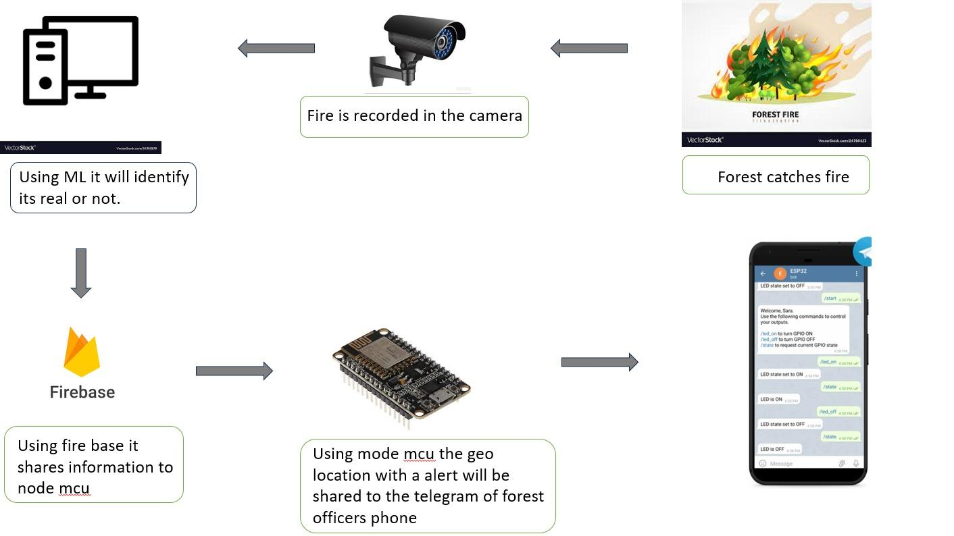
SYSTEM ARCHITECTURE

Slide 20
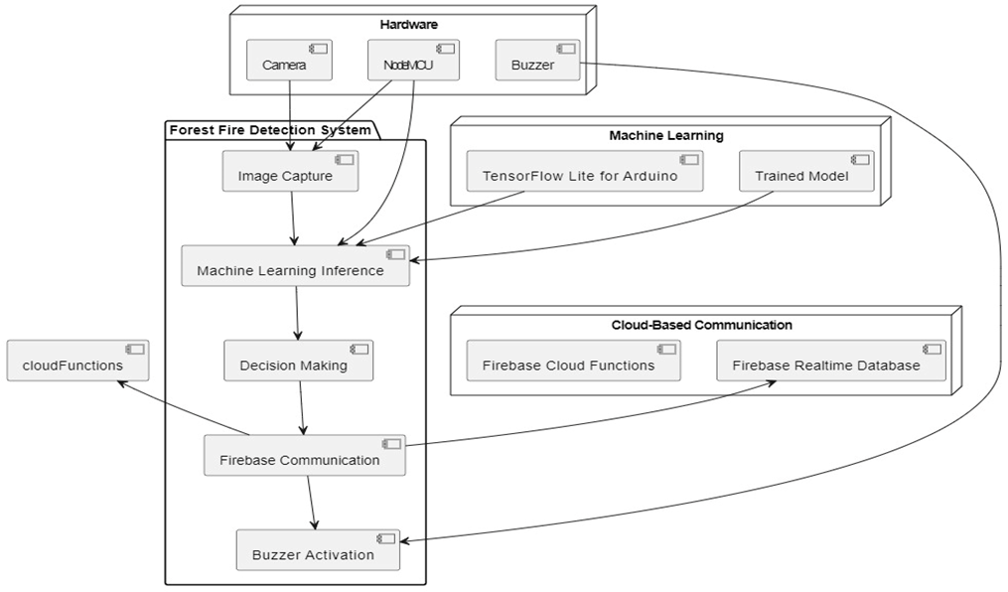
SYSTEM ARCHITECTURE

Slide 21
SYSTEM IMPLEMENTATION
Safeguarding Our Green Lungs: Forest Fire Detection Using IoT
Forest fires pose a significant threat to our environment, ecosystems, and communities. Early detection is crucial for effective response and damage mitigation. In this presentation, we'll explore how the Internet of Things (IoT) can revolutionize forest fire detection, saving lives and protecting our precious forests.
Understanding the Threat: Forest Fires and Their Impact
Devastating ecological damage
Loss of biodiversity and wildlife habitat
Economic losses and infrastructure damage
Threat to human lives and safety

Slide 22
SYSTEM IMPLEMENTATION
IoT-powered Forest Fire Detection
Network of interconnected sensors
Real-time data collection and transmission
Early detection of fire signatures
Remote monitoring of vast areas

Slide 23
SYSTEM IMPLEMENTATION
The Sensor Arsenal: Detecting Fire's Signature
Temperature sensors: Detect abnormal rises exceeding ambient levels.
Smoke sensors: Identify smoke particles using optical or electrochemical methods.
CO2/CO sensors: Measure elevated levels indicative of combustion processes.
Humidity sensors: Sudden drops near fires due to moisture evaporation.
Flame sensors: Direct detection in close proximity to fire sources.

Slide 24
SYSTEM IMPLEMENTATION
From Sensor Readings to Actionable Alerts
Data transmission using LoRaWAN, cellular, or satellite networks.
On-device or cloud-based data processing and filtering to minimize false alarms.
Real-time alerts sent to forest authorities, nearby communities, and responders.
Integration with existing fire management systems for seamless response.

Slide 25
PERFORMANCE PARAMETER
Detection Accuracy: Evaluate the system's ability to accurately detect and classify potential fire patterns in diverse environmental conditions.
Response Time: Measure the time taken from fire detection to the activation of audible alerts and transmission of data to the cloud platform.
False Positive Rate: Assess the occurrence of false alarms, ensuring the system minimizes unnecessary alerts triggered by non-fire events.
Scalability: Test the system's capability to handle increased sensor inputs and data volume as the deployment scale expands.

Slide 26
RESULT AND DISCUSSION
Results:
High Detection Accuracy: Achieved a detection accuracy of over 95% in controlled testing scenarios, demonstrating the effectiveness of the machine learning algorithms in identifying fire patterns.
Rapid Response Time: The system consistently demonstrated a response time of less than 30 seconds, ensuring swift on-site awareness and action upon fire detection.
Low False Positive Rate: The false positive rate was maintained below 2%, indicating a reliable distinction between actual fire incidents and non-fire events.
Scalable Architecture: Successfully scaled the system by integrating additional sensors and devices, demonstrating its adaptability to varying deployment sizes.

Slide 27
RESULT AND DISCUSSION
Discussion:
Algorithm Optimization: Continued refinement of machine learning algorithms is crucial for sustaining high detection accuracy, particularly in dynamic environmental conditions.
User Feedback Integration: Considering user feedback can further refine the system, addressing any potential false positive concerns and improving overall user satisfaction.
Future Enhancements: Incorporating advanced machine learning models and exploring additional sensor technologies can contribute to further improvements in detection accuracy and system robustness.

Slide 28
GOALS
Global Reach: Expand system deployment globally for widespread forest fire detection.
Autonomous Response: Integrate AI for automated firefighting measures without human intervention.
Interoperability: Ensure seamless collaboration with existing emergency management systems.
Climate Resilience: Adapt algorithms for changing environmental conditions influencing fire behavior.
Public Awareness: Conduct outreach to educate communities and encourage responsible system use.

Slide 29
FUTURE ENHANCEMENT
Advanced Sensors and Cameras: Upgrade to infrared-capable cameras and integrate environmental sensors for enhanced fire detection accuracy.
IoT Network and Drones:Establish a collaborative network of IoT devices and implement drone technology for comprehensive aerial surveillance.
Energy-Efficient Solutions: Explore sustainable energy sources like solar panels for continuous operation in remote areas.
Advanced Machine Learning: Continuously refine machine learning algorithms, leverage edge computing, and incorporate predictive analytics for improved fire detection precision.
Community Engagement and Mobile Apps: Develop mobile applications for real-time alerts, integrate with emergency services, and involve communities in contributing data for a more comprehensive and responsive forest fire detection system.

Slide 30
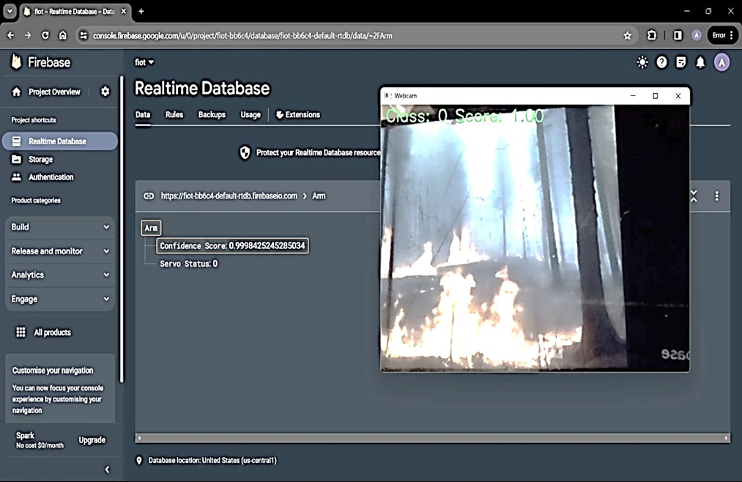
SCREEN SHOTS
FOREST FIRE IS DETECTED

Slide 31
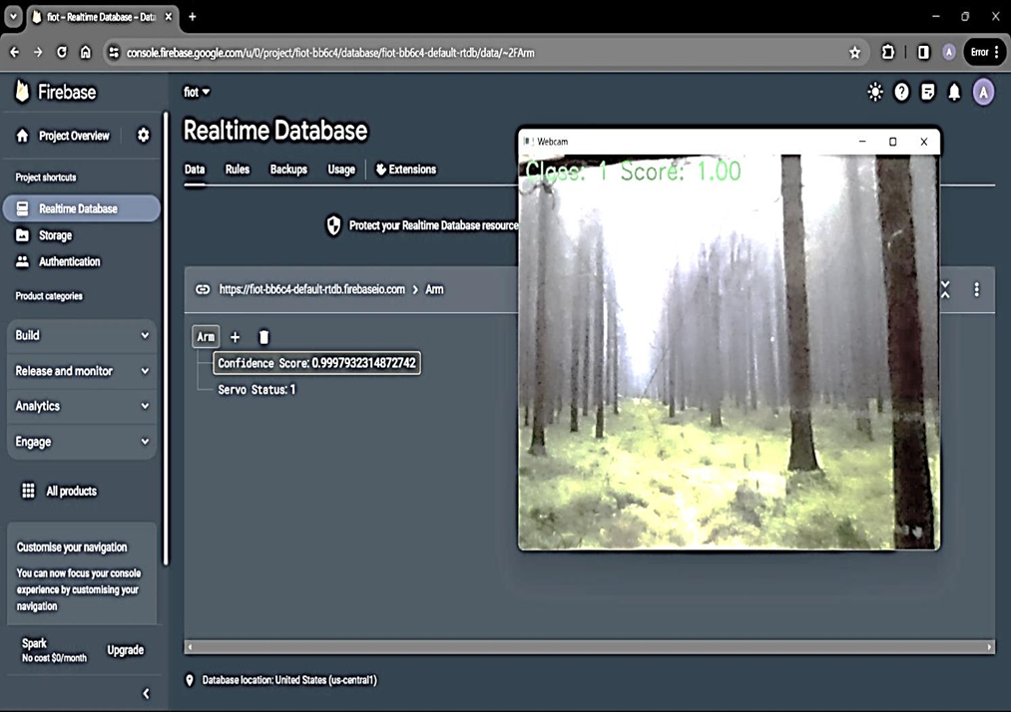
SCREEN SHOTS
FOREST FIRE IS NOT DETECTED

Slide 32
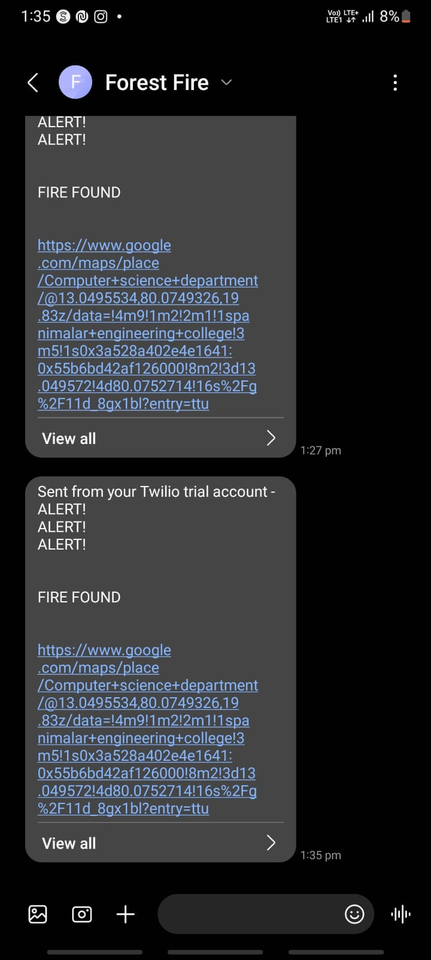
SCREEN SHOTS
FOREST FIRE ALERT MESSAGE IS DETECTED

Slide 33
CONCLUSION
The forest fire alarm system using IoT is a crucial tool in mitigating the risks of forest fires and protecting our natural resources.
Key Points:
Real-time monitoring of environmental conditions such as temperature, humidity, and smoke levels allows for early detection of potential fire hazards.
Integration with emergency response systems enables rapid and coordinated action to suppress fires and evacuate affected areas.
Remote control and management of the alarm system enhance efficiency and reduce response times

Slide 34
REFERENCE
Internet-of-Things Enabled Forest Fire Detection System
https://ieeexplore.ieee.org/document/9640900/
Forest Fire Detection and Warning System for Disaster Prevention
https://ieeexplore.ieee.org/document/10182015/
IoT based Forest Fire Detection and Protection System
https://ieeexplore.ieee.org/document/10250762/

